Slide 1
Identity Theft
Pub 4491
Pub 4012
TaxSlayer Manual

Slide 2

Identity Theft
Someone uses another's information, such as name, identifying number, or credit card number, without permission, to commit fraud or other crimes.
Victims of identity theft are victimized mostly through no fault of their own
Notes:
Usually, an identity thief uses a legitimate taxpayer’s identity to fraudulently file a tax return and claim a refund. Generally, the identity thief will use a stolen SSN to file a forged tax return and attempt to get a fraudulent refund early in the filing season.

Slide 3
Identity Theft (cont..)
IRS sends notices to taxpayers identified as victims (or potential victims)
Notice provides Identity Protection PIN victim needs when filing his or her 2016 tax return
Notes:
Be alert to possible identity theft if taxpayer receives an IRS notice or letter that states that:
More than one tax return for taxpayer was filed,
Taxpayer had a balance due, refund offset or had collection actions taken against him for a year he did not file a tax return, or
IRS records indicate taxpayer received wages from an employer unknown to him.

Slide 4
Identity Theft (cont.)
Ask taxpayer if s/he contacted IRS regarding identity theft or if IRS sent notice of potential identity theft
Note: question 11 on page 1 of Intake Interview form

Slide 5
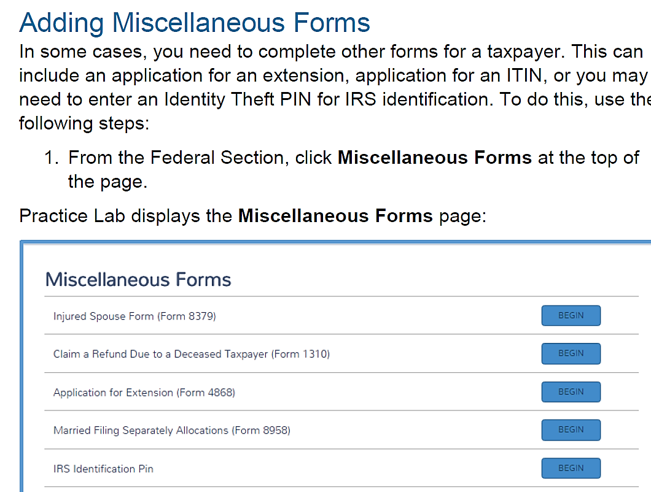
Identity Theft – Entering IRS Identification PIN in TaxSlayer
IRS Identification Pin
Notes:
This year required to enter IP PIN for dependents in dependent section of TaxWise Main Information Sheet.

Slide 6
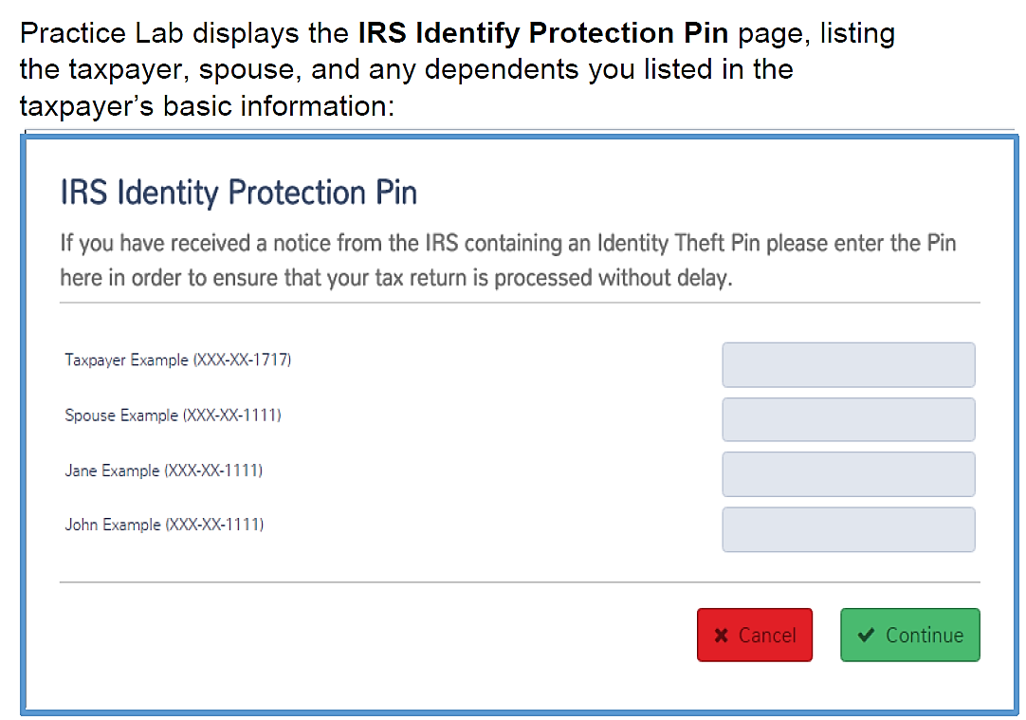
Identity Theft – Entering IRS Identification PIN in TaxSlayer

Slide 7
Identity Theft (cont)
If taxpayer received IP PIN but lost it, have taxpayer call ID Theft Toll-free Hotline: 800-908-4490
If hotline provides new IP PIN – e-file
If not – create paper return and advise taxpayer to follow hotline instructions

Slide 8
Identity Theft (cont)
If e-file rejected with indication that tax return for primary or secondary social security numbers has already been filed, give taxpayer:
  Paper copy of return to mail
  Letter with instructions
  Form 14039 – Identity Theft Affidavit

Slide 9
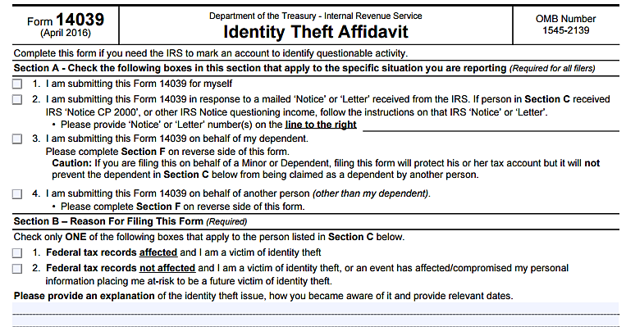
Form 14039

Slide 10
Recommendation…
E-file everyone for whom return is prepared
From taxpayer’s perspective
  Identify identity theft
  Potentially prevent identity theft
  Provide documentation of tax status
From IRS perspective
  Incremental “cost” of e-file is low
  Cost of dealing with identity theft is high
From AARP perspective
  Better tracks activity
  Creates IRS record of return if questions arise later
Notes:
Even if federal AGI is zero. Section 4.3.8 in Policy Manual – enter $1 on Line 21 Other Income and describe as “IN ORDER TO EFILE”
Recommending that those who are not required to file a return, file one anyway to help with ID Theft. Two purposes are served. 1) Taxpayer is alerted that someone has already filed a return using his/her SSN. 2) The filing may prevent someone from filing a fraudulent return with that SSN.

Slide 11
Additional Resources
www.irs.gov
  Forms and Publications
    Identity Theft
  TaxSlayer Manual Preparing a Return in Practice Lab

Slide 12
Identity Theft
Questions?
Comments?
Notes:
12

